Slide 1



PERFORMANCE REPORT
DIGITAL MARKETING SOLUTIONS (DMS)
AA Techdoc Resources
As of August 2024
Objective Traffic Budget Allocation RM (incl. 30% mgt fee)
Duration 31 July 2024 - 30 Aug 2024

Slide 2
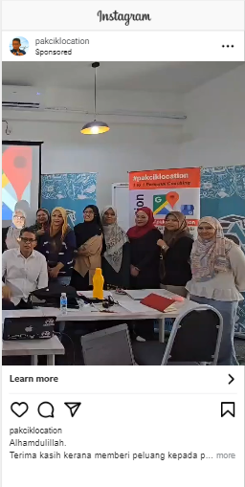
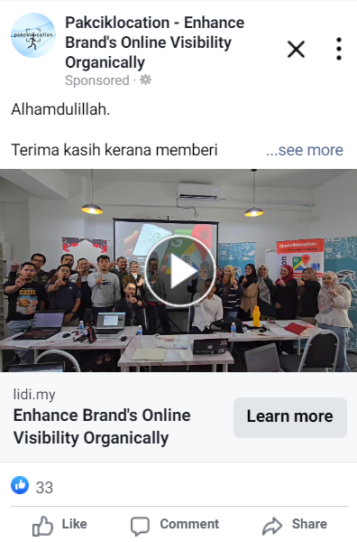
Your Advertisement
Still Image- Link Click

Slide 3





Summary Report
24,333 REACH
The number of people who saw your adverts at least once.
3,380 ENGAGEMENT
The total number of actions that people take involving your adverts.
2,169 LINK CLICKS
The number of clicks on links within the ad that led to advertiser-specified destinations, on or off Facebook.
53,290 IMPRESSIONS
The number of times that your adverts
were on-screen.
2,356 CLICKS
The number of clicks on your adverts.
Performance by Demographic

Slide 4
Performance by Demographic
Age | Gender | Reach | Impressions | Link Clicks | Clicks | CTR (%) | Post Engagement
18-24 | female | 607 | 1155 | 40 | 43 | 3.72 | 65
18-24 | male | 2101 | 4064 | 144 | 158 | 3.9 | 202
25-34 | female | 1518 | 3363 | 122 | 136 | 4.04 | 186
25-34 | male | 8084 | 17139 | 630 | 683 | 3.99 | 973
35-44 | female | 1062 | 2645 | 138 | 145 | 5.48 | 203
35-44 | male | 7270 | 17166 | 769 | 830 | 11.08 | 1190
45-54 | female | 328 | 656 | 23 | 24 | 3.65 | 39
45-54 | male | 1813 | 4261 | 172 | 189 | 4.43 | 330
55-64 | female | 184 | 371 | 19 | 23 | 6.19 | 23
55-64 | male | 503 | 929 | 42 | 48 | 28.35 | 67
65+ | female | 296 | 610 | 36 | 40 | 6.55 | 49
65+ | male | 567 | 931 | 34 | 37 | 3.97 | 53
Findings :
Males under the group age 35-44 are more active to take action than others

Slide 5
Performance by Geographic
Region | Reach | Impressions | Link clicks | Clicks | CTR (%) | Post engagement
Malacca | 1286 | 3026 | 117 | 121 | 3.99 | 180
Negeri Sembilan | 2365 | 6211 | 263 | 281 | 4.52 | 381
Selangor | 14213 | 30869 | 1260 | 1374 | 4.45 | 1949
Kuala Lumpur | 6391 | 13083 | 525 | 572 | 4.37 | 863
Putrajaya | 80 | 53396 | 4 | 8 | 7.84 | 7
Findings :
From the table above, most likes is coming from Putrajaya region followed by other region.

Slide 6
Engagement by Demographic
Age | Gender | Post reactions | Post saves | Post shares | Link clicks
18-24 | female |  |  |  | 40
18-24 | male | 2 |  |  | 144
18-24 | unknown
25-34 | female | 2 |  |  | 122
25-34 | male | 8 |  |  | 630
25-34 | unknown
35-44 | female | 4 |  |  | 138
35-44 | male | 5 |  |  | 766
35-44 | unknown |  |  |  | 3
45-54 | female |  |  |  | 23
45-54 | male | 1 |  |  | 172
45-54 | unknown
55-64 | female |  |  |  | 19
55-64 | male |  |  |  | 39
55-64 | unknown |  |  |  | 3
65+ | female |  |  |  | 36
65+ | male |  |  |  | 34
NOTE :
Post Reaction : The number of reactions on your ads. The reactions button on an ad allows people to share different reactions to its content: like, love, haha, wow, sad or angry.
Post Share : The number of shares of your adverts. People can share your adverts or posts on their own or friends' Timelines, in groups and on their own Pages.
Link clicks : The number of clicks on links within the ad that led to destinations or experiences, on or off Facebook. For ads promoting Instagram profile views, link clicks include clicks on the ad header or comments that led to the advertiser's profile.

Slide 7
CONTACT US
wecare.inquiry@tm.com.my

